Slide 1
Chicago Traffic Crashes Analysis
Data Champs

Slide 2
OUTLINE
Introduction
Data Set
Quality Issues
Research Questions
Analyzing Process
Findings of Research Questions
If we had to this Project Again

Slide 3
Introduction
We are Data Champs, team of two members.
Shivani Konyala
Yeshwanth Nellikanti

Slide 4
Data Set
The team is responsible for selecting a large data dataset, developing research questions to break down the information, performing data analysis, and detailing the results of sightings.
We went through several datasets from the suggested sites, we investigated some of the datasets like a dual credit card, cybersecurity, and a few others.
Eventually, the team selected Chicago Traffic Crashes, as it helps to analyze the traffic crashes of Chicago. We intended to analyze the data from 2018 as it has information of all the districts of Chicago.

Slide 5
Quality ISSUES
For one of the research questions, we need the primary contributory cause of the crash. The Details in the primary contributory cause are not blank but for most of the records, the cause was unable to determine.
The Chicago traffic department would know the importance of detailed description of the primary cause for analyzing the crashes and they would take necessary measures to avoid crashes in future.

Slide 6
Research Questions
What is the hour-wise number of crashes in Chicago from 2018 to 2020?
Biannually, how many crashes have been reported in Chicago city from 2018 to 2020?
Biannually, what are the top 5 contributory causes of fatalities reported in traffic crashes from 2018 to 2020?

Slide 7
Research Questions
For analyzing the dataset, the team firstly have chosen the research questions based on the available data. (Avoiding missing data discrepancy)
Secondly, the team has further filtered the research questions based on whether they provide value to analyze the traffic crash problems.
Furthermore, the team concentrated on choosing questions where the aspects like crash rate, fatality rate, road defects, and hour-wise data can be analyzed

Slide 8
Analysing Process
To analyze the research questions, we have used PYSPARK SQL.
To visualize the findings of the research questions, we have used tableau software, and excel.

Slide 9
Difference between Pig or Spark
PIG
SPARK
Slower than Spark but productive for smaller scripts.
In pig there are few built in functions for few operations and functionalities.
Spark is really fast and provides run time capacity.
Availability of stack libraries like SQL, Mlib and Streaming modules.

Slide 10
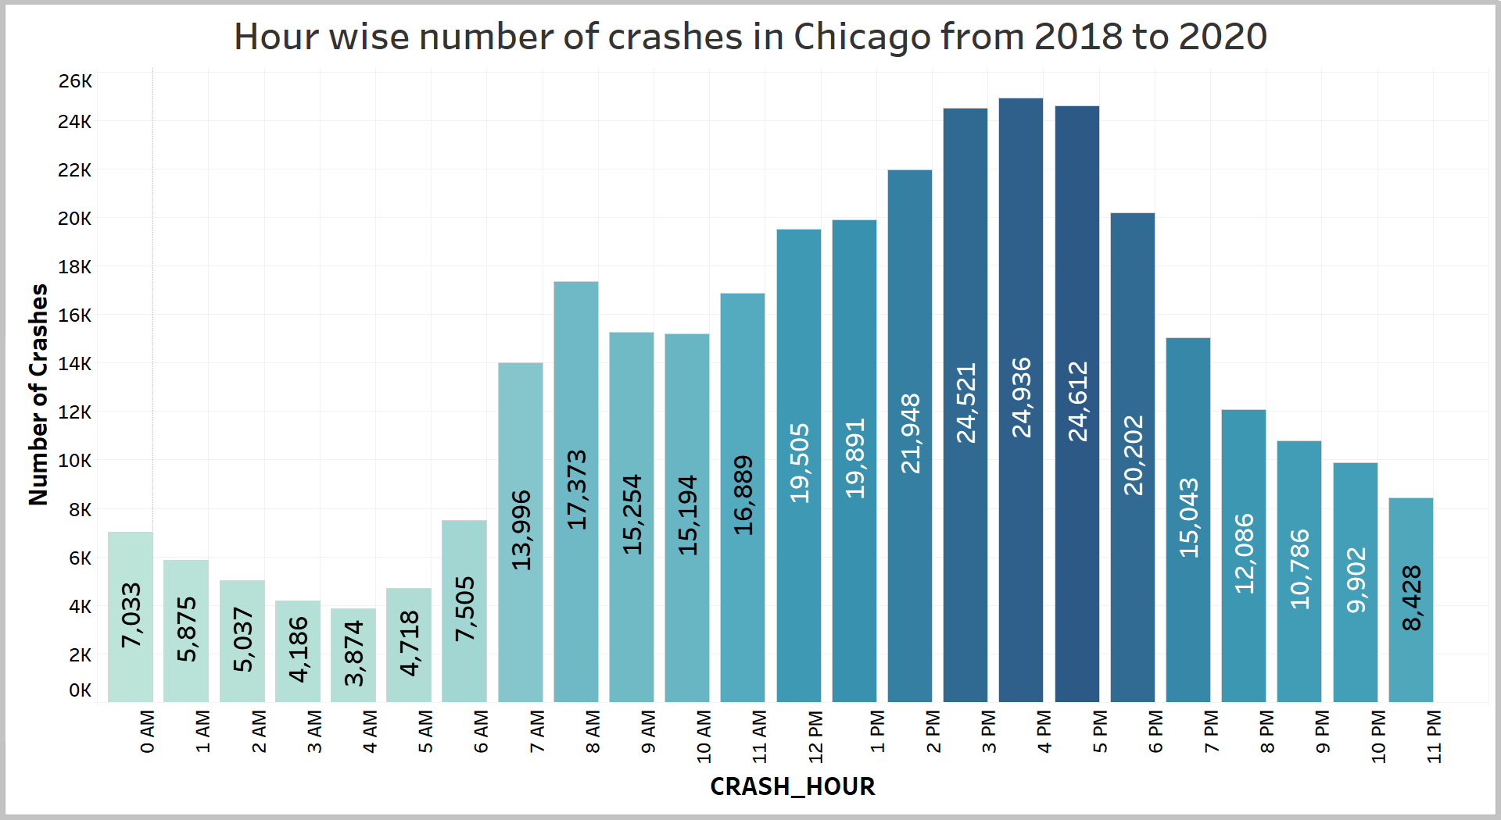
FINDINGS of Research question
1.What is the hour-wise number of crashes in Chicago from 2018 to 2020?

Slide 11
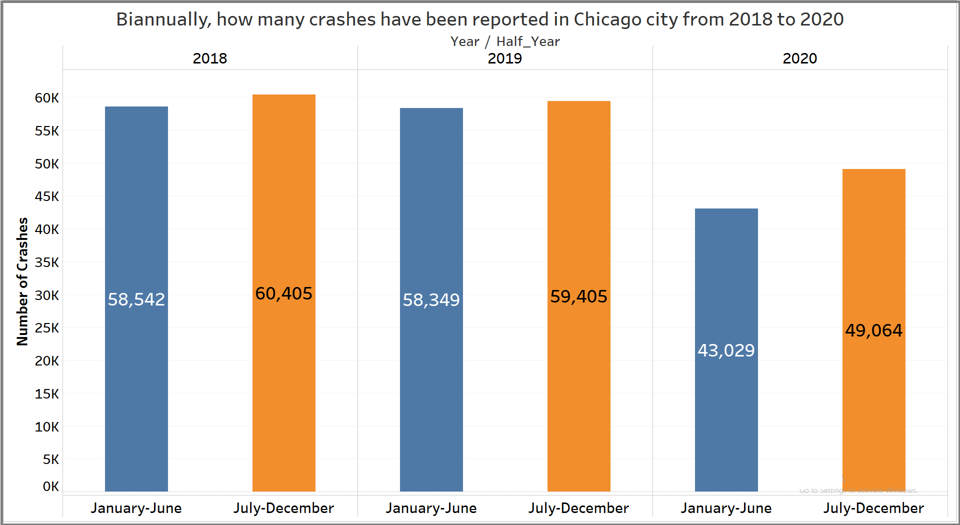
FINDINGS of Research question
2. Biannually, how many crashes have been reported in Chicago city from 2018 to 2020?

Slide 12
FINDINGS of Research question
3. Biannually, what are the top 5 contributory causes of fatalities reported in traffic crashes from 2018 to 2020?
Rank | Jan-Jun (2018) | Jul-Dec (2018) | Jan-Jun (2019) | Jul-Dec (2019) | Jan-Jun (2020) | Jul-Dec (2020)
1 | Unable to determine 16 | Unable to determine 18 | Unable to determine 16 | Unable to determine 12 | Unable to determine 23 | Unable to determine 34
2 | Physical condition of Driver 10 | Failing to Yield 9 | Disregarding Traffic Signals 8 | Failing to Reduce speed 8 | Failing to Yield 7 | Physical condition of Driver 13
3 | Exceeding Speed Limit 9 | Disregarding Traffic Signals 5 | Physical condition of Driver 7 | Failing to Yield 8 | Physical condition of Driver 6 | Disregarding Traffic Signals 11
4 | Failing to Reduce speed 4 | Exceeding Speed Limit 5 | Operating Vehicle Issue 4 | Disregarding Traffic Signals 4 | Disregarding Traffic Signals 5 | Failing to Yield 9
5 | Failing to Yield 4 | Failing to Reduce speed 5 | Failing to Reduce speed 2 | Physical condition of Driver 4 | Failing to Reduce speed 4 | Failing to Reduce speed 8

Slide 13
If we had to this Project Again?
If we had to this project again, we would consider different questions like
If there isn’t any missing data in weather, we would like to determine which weather condition was most prevalent for each type of crash.
Display a cluster map showing the locations of crashes involving a hit and run.

